Slide 1

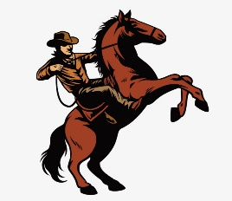
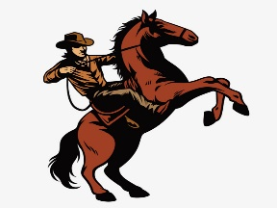
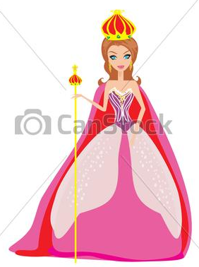
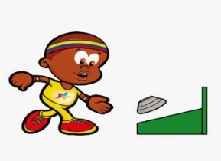
San Francisquito
Calendar
Sweet and cultural corner of Colombia, a people sure of their future¡¡
M
A
R
C
H
2019
MONDAY | TUESDAY | WEDNESDAY | THURSDAY | FRIDAY | SATURDAY | SUNDAY
1 One | 2 Two | 3 Three | 4 Four | 5 Five | 6 Six | 7 Seven
8 Eight | 9 Nine | 10 Ten | 11 Eleven | 12 Twelve | 13 Thirteen | 14 Fourteen
15 Fifteen | 16 Sixteen | 17 Seventeen | 18 Eighteen | 19 Nineteen | 20 Twenty | 21 Twenty-one
22 Twenty-two | 23 Twenty-three | 24 Twenty-four | 25 Twenty-five | 26 Twenty-six | 27 Twenty-seven | 28 Twenty-eight
29 Twenty-nine | 30 Thirty | 31 Thirty-one
Ride through the mountains a nice outdoor experience
Reign of love, we show our feminine beauty to the world.
National “Tejo” Day, is our sport¡¡

Slide 2

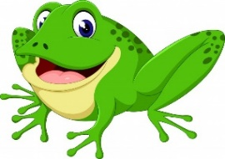
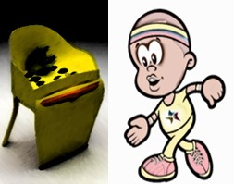




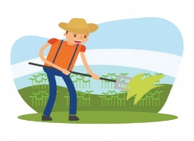
San Francisquito
Calendar
Sweet and cultural corner of Colombia, a people sure of their future¡¡
A
P
R
I
L 2019
MONDAY | TUESDAY | WEDNESDAY | THURSDAY | FRIDAY | SATURDAY | SUNDAY
1 One | 2 Two | 3 Three | 4 Four | 5 Five | 6 Six | 7 Seven
8 Eight | 9 Nine | 10 Ten | 11 Eleven | 12 Twelve | 13 Thirteen | 14 Fourteen
15 Fifteen | 16 Sixteen | 17 Seventeen | 18 Eighteen | 19 Nineteen | 20 Twenty | 21 Twenty-one
22 Twenty-two | 23 Twenty-three | 24 Twenty-four | 25 Twenty-five | 26 Twenty-six | 27 Twenty-seven | 28 Twenty-eight
29 Twenty-nine | 30 Thirty
A celebration with sport¡¡ for our most representative animal. The Rana
In Holy Week, know our churches and their beautiful architecture
A holiday for our farmers and exalt their noble work¡¡

